Slide 1

SQL Murder Mystery: Who Killed the CEO?
Solving a corporate murder using SQL data analysis

Slide 2




Case Overview
Date of Incident
Investigation Method
October 15, 2025 — TechNova's CEO found dead in his office at 9:00 PM
The entire investigation relies solely on SQL queries to uncover the truth
Data Sources
Keycard logs, call records, employee alibis, forensic evidence, and HR databases

Slide 3

The Hidden Story
David Kumar, a talented DevOps engineer, discovered a critical flaw in the CEO's new AI project. His warnings were ignored, his work was stolen, and the CEO planned to fire him. Driven by betrayal and fear, David confronted the CEO — and the situation turned fatal.
Behind every crime lies a motive. Understanding the human story helps us interpret the digital evidence that will ultimately reveal the killer.

Slide 4
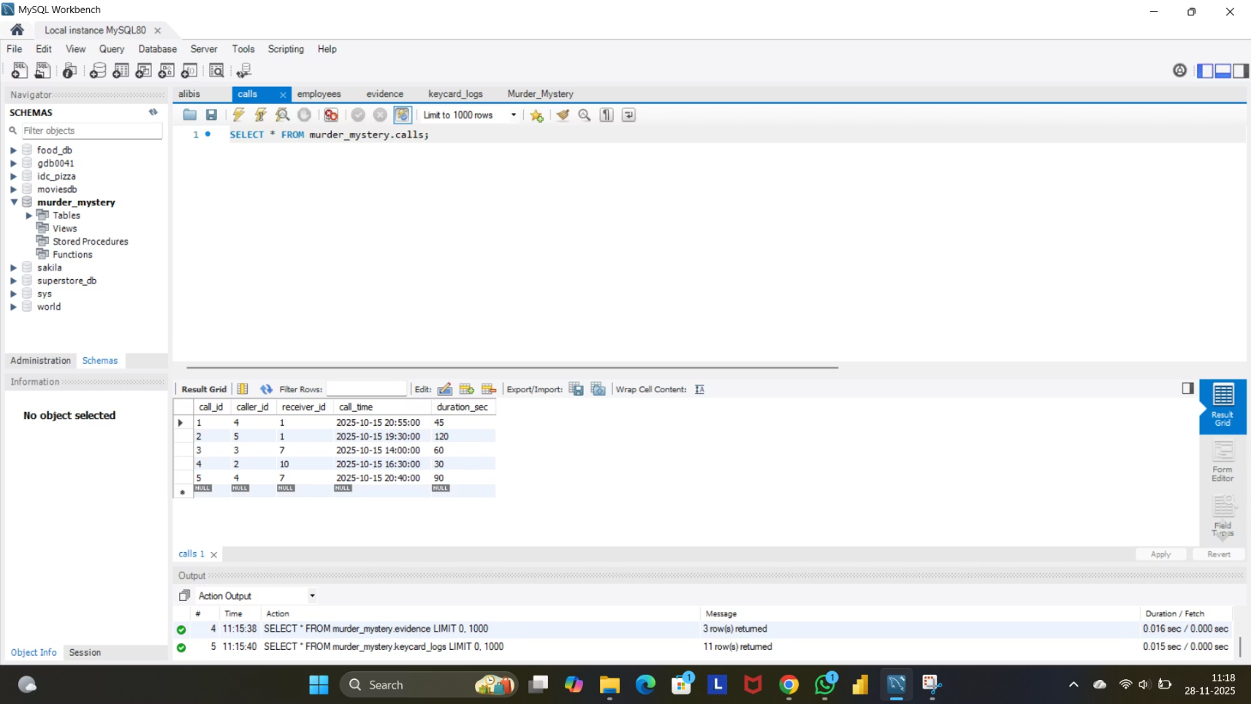
Database Structure
Five interconnected tables hold the key to solving this corporate murder mystery. Each database contains crucial forensic evidence waiting to be uncovered through strategic SQL queries.
01
02
03
employees
keycard_logs
calls
Personnel records, departments, and contact information
Every room entry and exit with precise timestamps
Phone call records including duration and timing
04
05
alibis
evidence
Employee-provided statements of their whereabouts
Physical forensic findings from the crime scene

Slide 5





Investigation Plan
A systematic forensic approach combining multiple data sources to build an irrefutable case through SQL-based digital detective work.
Crime Scene Identification
Query evidence table to pinpoint exact location and estimated murder time
Access Log Analysis
Track room access using keycard logs during the critical time window
Alibi Verification
Cross-reference claimed alibis against actual movement data for inconsistencies
Call Pattern Analysis
Identify suspicious communication activity around the time of death
Evidence Synthesis
Combine all SQL findings to reveal the killer's identity conclusively

Slide 6
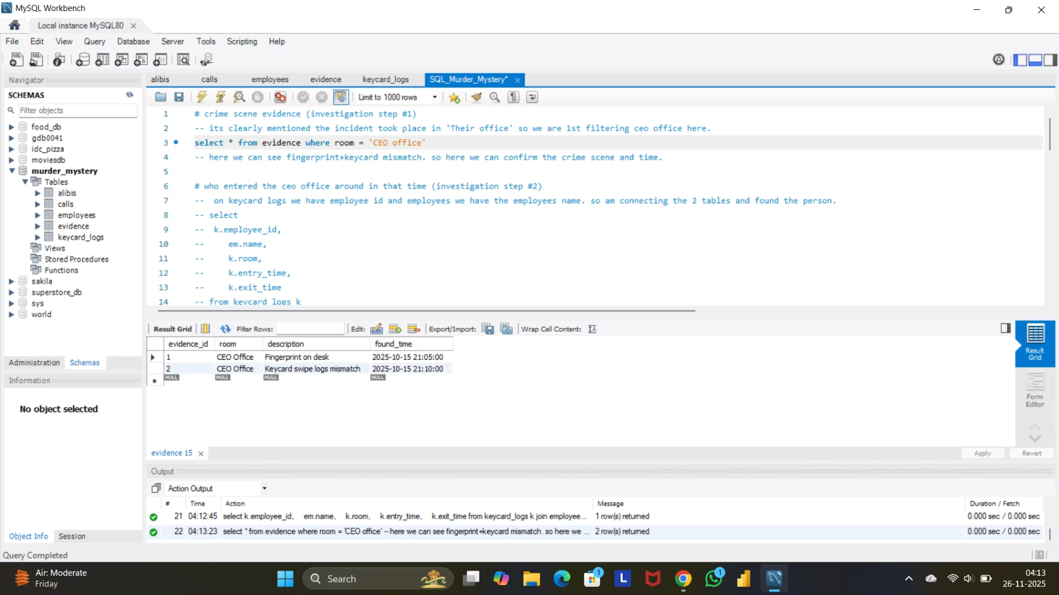
Step 1: Crime Scene & Time
Initial Query
We begin by querying the evidence table to filter entries for the CEO Office location.
SELECT * FROM evidenceWHERE location = 'CEO Office'ORDER BY found_time;
Key Finding
The earliest found_time was recorded at approximately 9:05 PM, indicating the murder likely occurred around 9:00 PM on October 15, 2025.

Slide 7
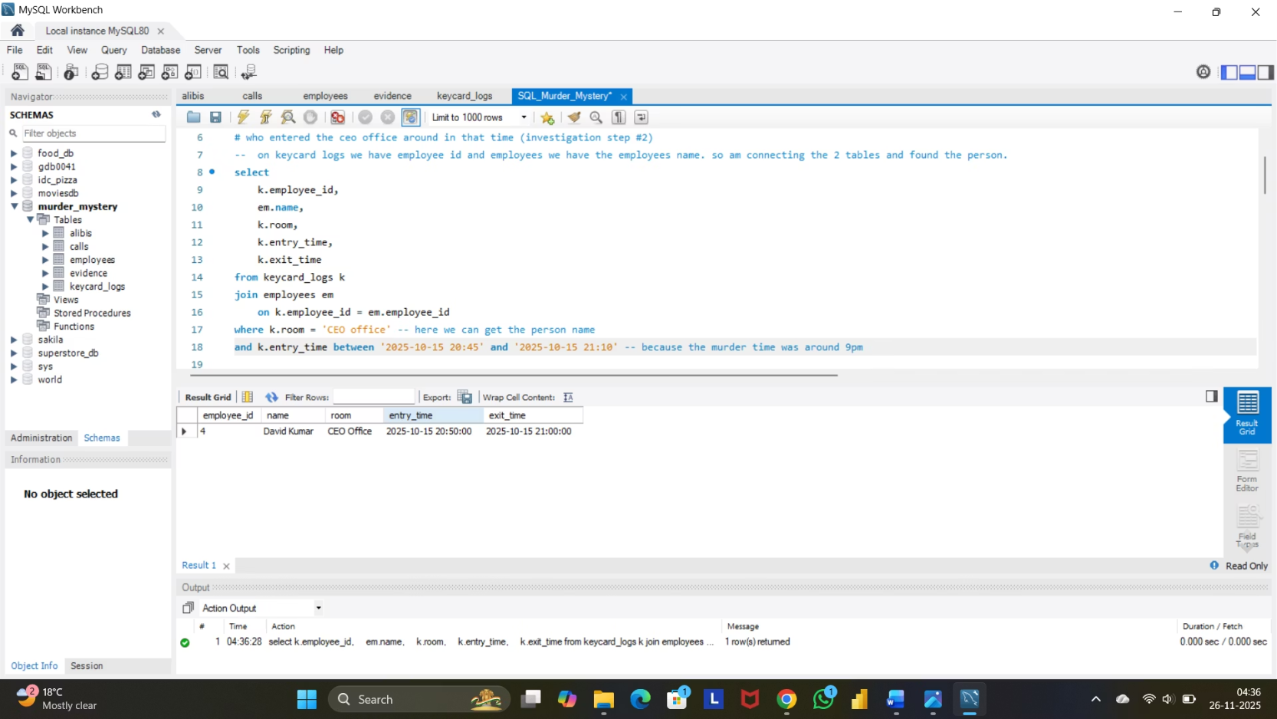
Step 2: Room Access Logs
Keycard Analysis
We query the keycard_logs table, filtering for entries into the CEO Office between 20:45 and 21:10 — the critical time window.
select k.employee_id, em.name, k.room, k.entry_time, k.exit_timefrom keycard_logs kjoin employees em on k.employee_id = em.employee_idwhere k.room = 'CEO office' and k.entry_time between '2025-10-15 20:45' and '2025-10-15 21:10'
Critical Discovery
Only one person entered the CEO Office during this narrow window, making them the prime suspect.

Slide 8
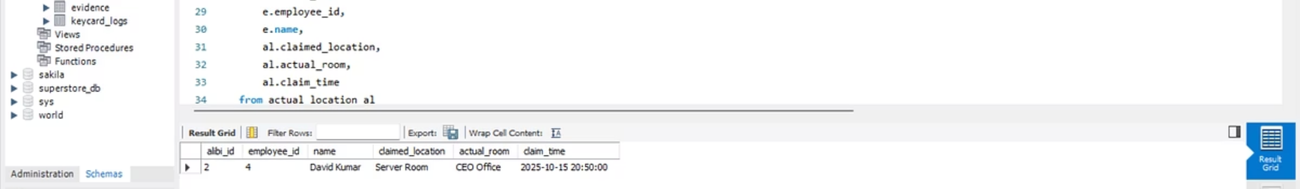
Step 3: Alibi Verification
Cross-referencing claimed alibis with actual keycard movement data reveals a critical discrepancy. The suspect's stated location does not match their digital footprint.
with actual_location as (select a.*, k.room as actual_roomfrom alibis ajoin keycard_logs k on a.employee_id = k.employee_id and claim_time between k.entry_time and k.exit_time) select al.alibi_id, e.employee_id, e.name, al.claimed_location, al.actual_room, al.claim_timefrom actual_location aljoin employees e on e.employee_id = al.employee_idorder by al.alibi_id
1
100%
False Alibi Detected
Data Match
Only one employee's alibi contradicts the keycard data
Keycard logs provide irrefutable proof of actual location

Slide 9
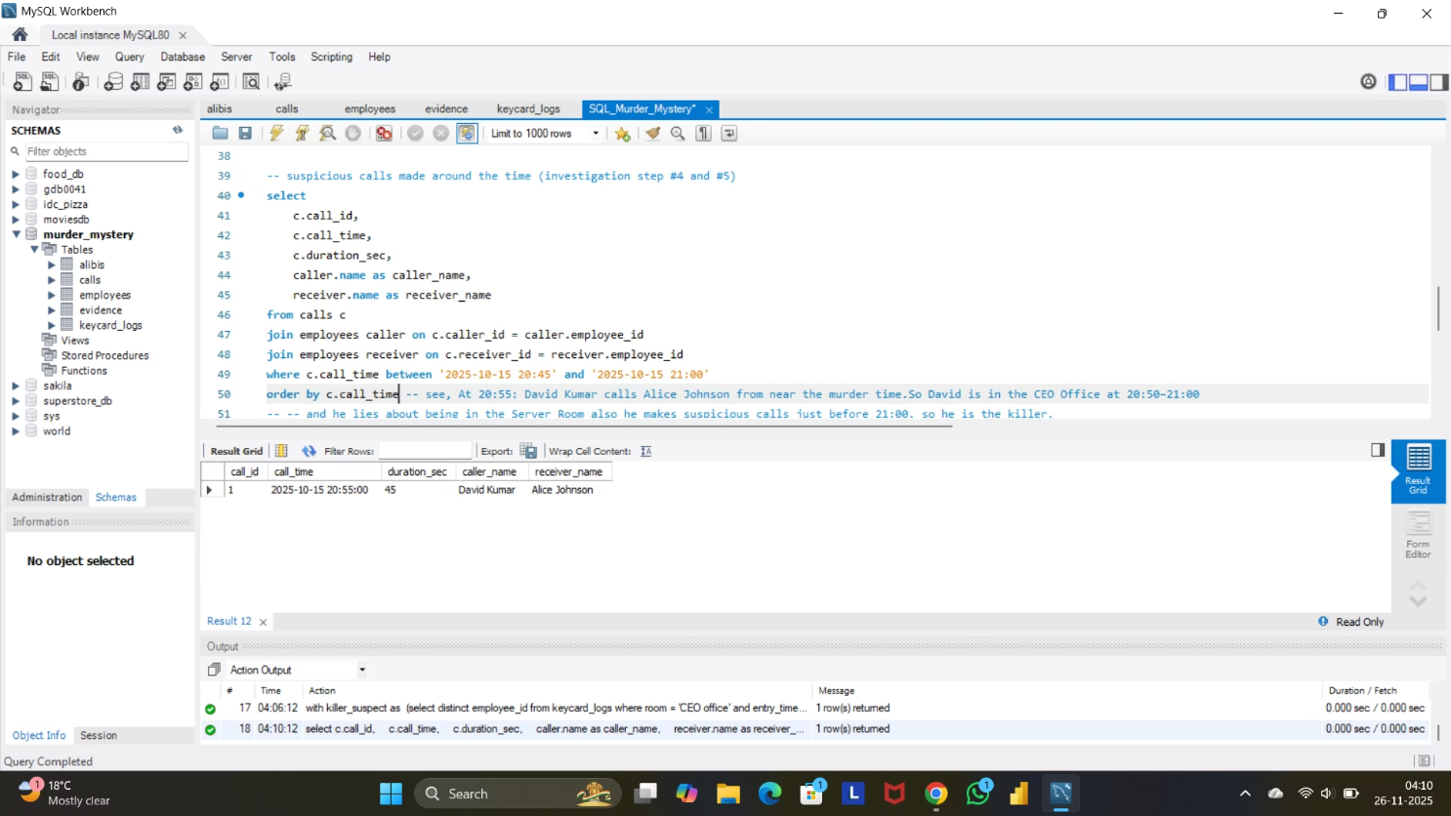
Step 4: Suspicious Call Activity
Call Record Analysis
Querying the calls table for activity between 20:45 and 21:00 reveals a brief, suspicious call placed just minutes before the murder.
select c.call_id, c.call_time, c.duration_sec, caller.name as caller_name, receiver.name as receiver_namefrom calls cjoin employees caller on c.caller_id = caller.employee_idjoin employees receiver on c.receiver_id = receiver.employee_idwhere c.call_time between '2025-10-15 20:45' and '2025-10-15 21:00'order by c.call_time
The Pattern Emerges
A short call, placed in close proximity to the murder timeframe, aligns perfectly with our suspect's keycard entry and false alibi. All forensic evidence now points toward one individual.

Slide 10
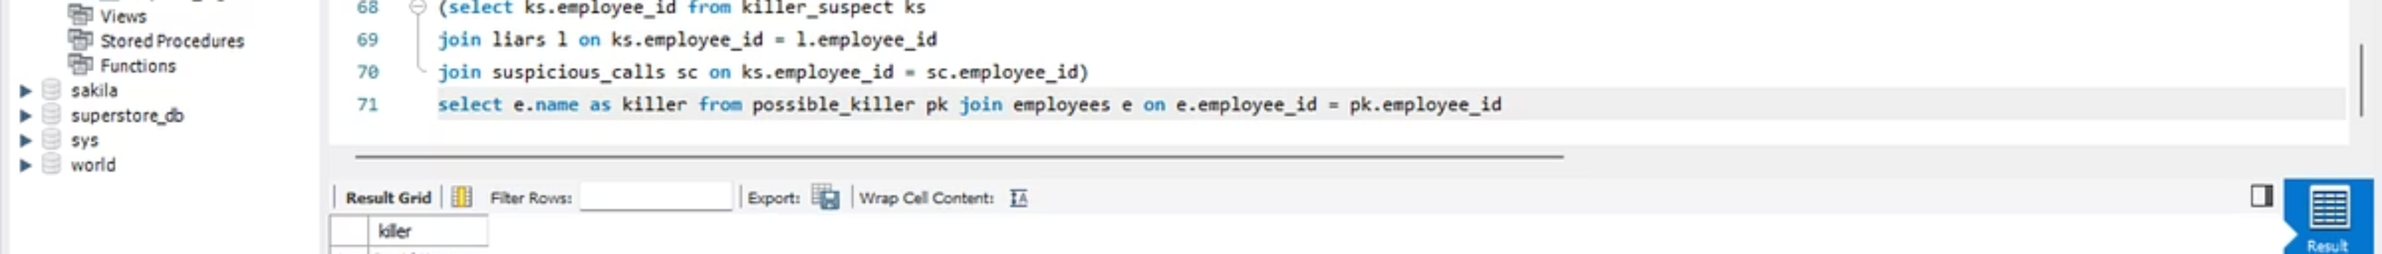
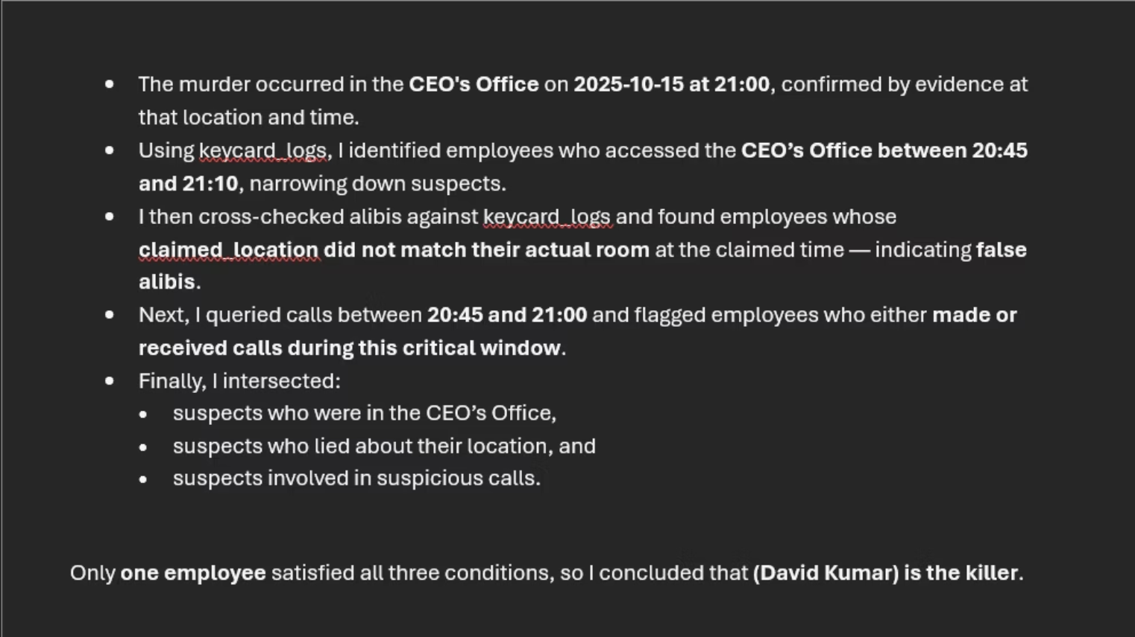
Final Verdict
By combining all database tables using strategic SQL joins, we identified the only person whose digital footprint matched every critical piece of evidence: room access, call records, and false alibi.
In the end, the data exposed the truth. The killer was David Kumar.

